Slide 1
LEGAL AND ENVIRONMENTAL BOTTLENECKS AND OPPORTUNITIES FOR SLAG-BASED PRODUCTS VALORISATION
6th International Slag Valorisation Symposium
Science, Innovation & Entrepreneurship in Pursuit of a Sustainable World
01-05 April 2019 - Mechelen, Belgium
Vincent BASUYAU - Resource Efficiency and Raw Materials Policy Officer
European Commission
Directorate-General for Internal Market, Industry, Entrepreneurship and SMEs
Resource Efficiency and Raw Materials Unit C.2
Notes:
The presentation is structured in two parts:
Raw materials policy and strategy in the context of the Commission priorities and the renewed industrial policy and strategy
Mining regulatory framework in the EU
Important to clarify:
Raw materials, as defined in the Raw Materials Initiative, means non-energy, non-agricultural raw materials: metallic minerals, industrial minerals, construction materials, wood, natural rubber. In this presentation we are covering only metallic minerals, industrial minerals and construction materials.
Energy raw materials (uranium, coal and conventional and non-conventional hydrocarbons are the competence of DG ENER

Slide 2
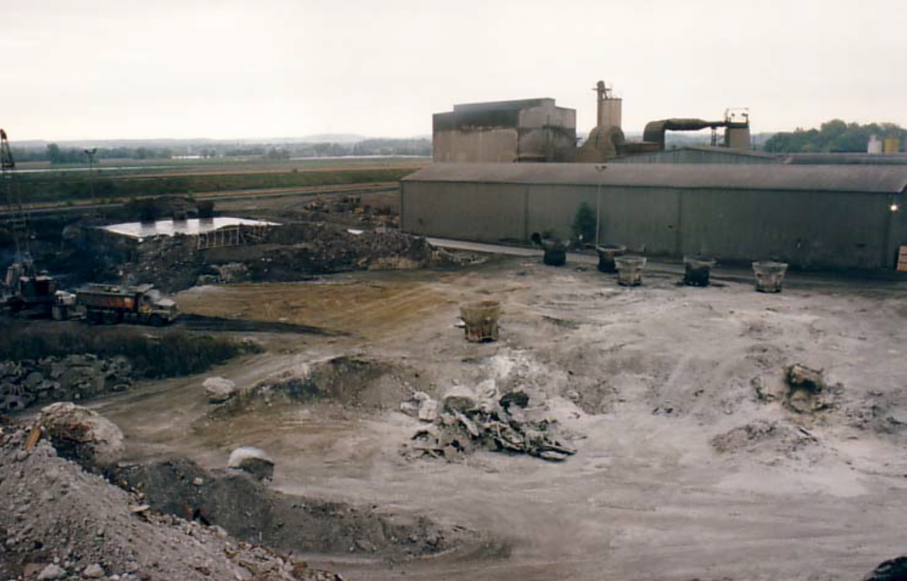
Content
Introduction
Steel slag potential for valorisation
Recovery of slag, environmental regulations and standards from MS and the EU
Technical, environmental and economic challenges
EU's policies and slag valorisation
Conclusion

Slide 3
Introduction
Industrial residues
Process and characteristics
Secondary raw materials for construction
Technical, environmental, economic and legal challenges
Environmental drivers?
  EoW criteria
  By-products/ standards
  Carbon footprint

Slide 4
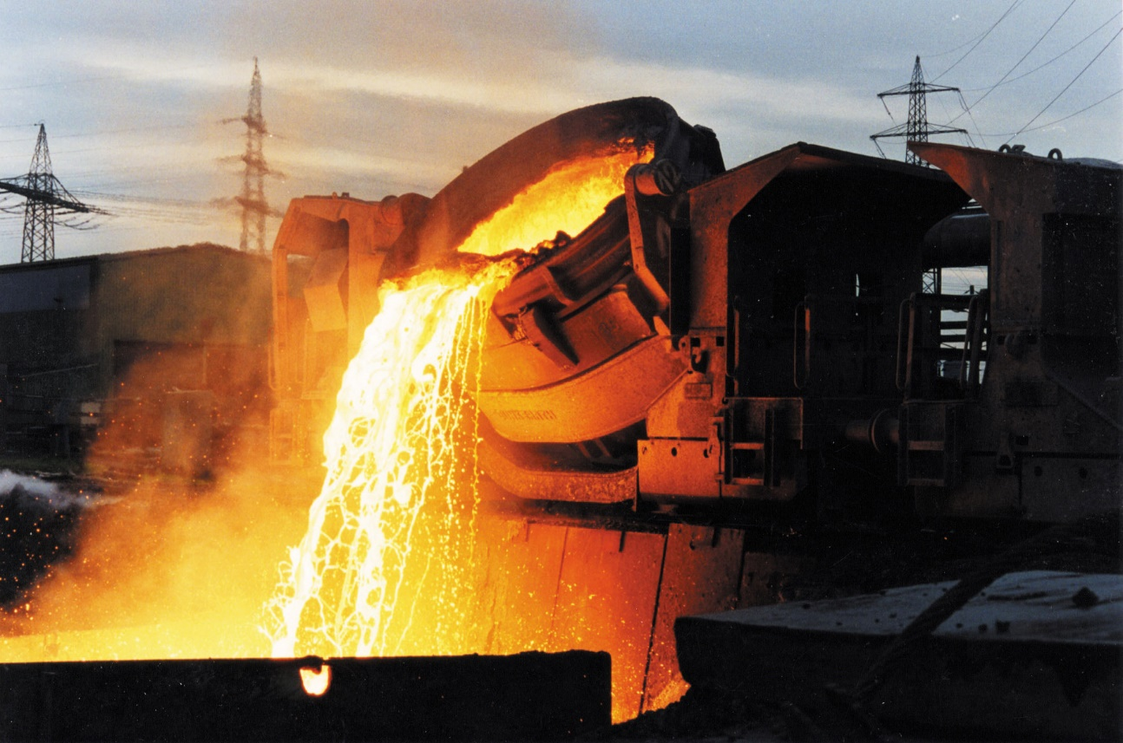
1. Steel slag potential for valorisation
a significant stream of industrial waste presenting a real potential for valorisation
Slag a non-metallic rock-like material
Industrial residues co-generated by steel production
  Blast furnace slags
  Steel slags
Notes:
Slag is a generic name for a non-metallic rock-like material produced together with the metallic products, which is an important secondary raw material flow.
Slags occur both in ferrous and non-ferrous metal production. Slags are non-metallic mineral materials resulting from metallurgical thermal processes such as the extraction of iron from iron ore, the conversion of pig iron into steel, and the refinement of crude steel into basic products of various steel grades. Blast furnace slags and steel slags are well-known residues classified as waste, by-products or secondary materials generated by steel industries. In the smelting process, slags, in their liquid state, have a different density to the melted metal and are therefore separable.
The iron and steel industry uses two main production routes: blast furnaces (BF) and electric arc furnaces (EAFs). The former uses iron ore as an input to produce pig iron, which is then converted into steel via the converter process (i.e. using pure oxygen to remove excess carbon). The latter uses mostly scrap and may add iron-bearing sources like direct reduced iron or pig iron, as required. The characteristics of slag from blast furnaces, steel converters and from electric arc furnaces are different, showing thus different properties and fields of applications.
Steel slag has particular properties such as high strength, high density, and good polish stone values. This makes it very suitable for use as aggregates for asphalt mixtures and as a reinforcement and stabilisation base for shores and rivers. However, the swelling potential of some kinds of steel slags may be an important barrier for reuse as a secondary construction material.
EUROSLAG indicates that each year the EU generates 48 million tonnes of ferrous slags, whereas EUROFER indicated that, in 2013, EU28 produced 166 million tonnes of crude steel.
According to EUROSLAG, 87% of the ferrous slags are used in construction applications (cements, concrete, engineering works…). Other valuable applications include agriculture, where silicate contents are used as fertiliser.

Slide 5
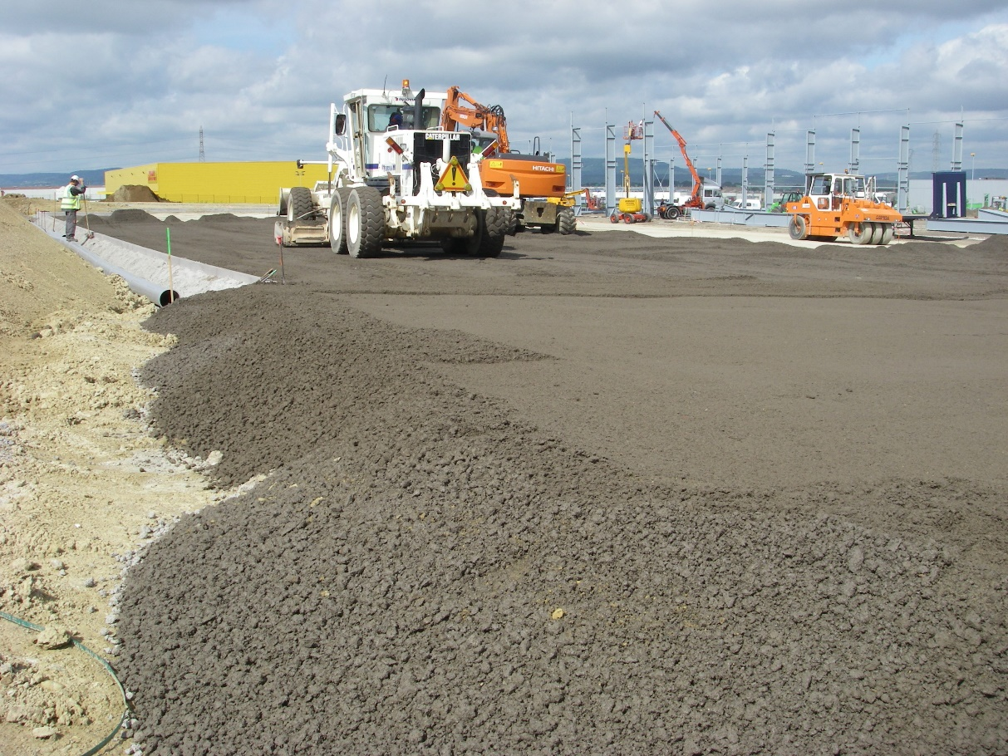
1. Steel slag potential for valorisation
a significant stream of industrial waste presenting a real potential for valorisation
Different characteristics and properties
    High density, strength, PSV = Aggregates for asphalt
    Free lime and magnesia = swelling potential
48 million tonnes p.y.
87% recovered in
    Aggregates
    Cement
    Concrete
    Insulation mineral wool
    Fertilisers
Notes:
Slag is a generic name for a non-metallic rock-like material produced together with the metallic products, which is an important secondary raw material flow.
Slags occur both in ferrous and non-ferrous metal production. Slags are non-metallic mineral materials resulting from metallurgical thermal processes such as the extraction of iron from iron ore, the conversion of pig iron into steel, and the refinement of crude steel into basic products of various steel grades. Blast furnace slags and steel slags are well-known residues classified as waste, by-products or secondary materials generated by steel industries. In the smelting process, slags, in their liquid state, have a different density to the melted metal and are therefore separable.
The iron and steel industry uses two main production routes: blast furnaces (BF) and electric arc furnaces (EAFs). The former uses iron ore as an input to produce pig iron, which is then converted into steel via the converter process (i.e. using pure oxygen to remove excess carbon). The latter uses mostly scrap and may add iron-bearing sources like direct reduced iron or pig iron, as required. The characteristics of slag from blast furnaces, steel converters and from electric arc furnaces are different, showing thus different properties and fields of applications.
Steel slag has particular properties such as high strength, high density, and good polish stone values. This makes it very suitable for use as aggregates for asphalt mixtures and as a reinforcement and stabilisation base for shores and rivers. However, the swelling potential of some kinds of steel slags may be an important barrier for reuse as a secondary construction material.
EUROSLAG indicates that each year the EU generates 48 million tonnes of ferrous slags, whereas EUROFER indicated that, in 2013, EU28 produced 166 million tonnes of crude steel.
According to EUROSLAG, 87% of the ferrous slags are used in construction applications (cements, concrete, engineering works…). Other valuable applications include agriculture, where silicate contents are used as fertiliser.

Slide 6
2. Environmental regulations and standards from MS and the EU
Waste Framework Directive (2008/98/EC)
EU Water Framework Directive
EU Waste Catalogue
EU Council Decision on the Landfill of Waste
REACH Regulation
Construction Products Regulation (CPR)

Slide 7
Waste vs. by-product
2. Environmental regulations and standards from MS and the EU
Waste Framework Directive (2008/98/EC)
  Article 4: hierarchy of waste treatment
  Definition of waste, recycling and recovery
  Article 5: by-products vs. waste
  Article 6: EoW criteria

Slide 8
REACH regulation
2. Environmental regulations and standards from MS and the EU
REACH regulation EC No 1907/2006
  Recovery process = manufacturing
  Ferrous slags = UVCB
  Slag as hydraulic binder = chemical composition is key = substance
  Slag as aggregates = article as other aggregates

Slide 9
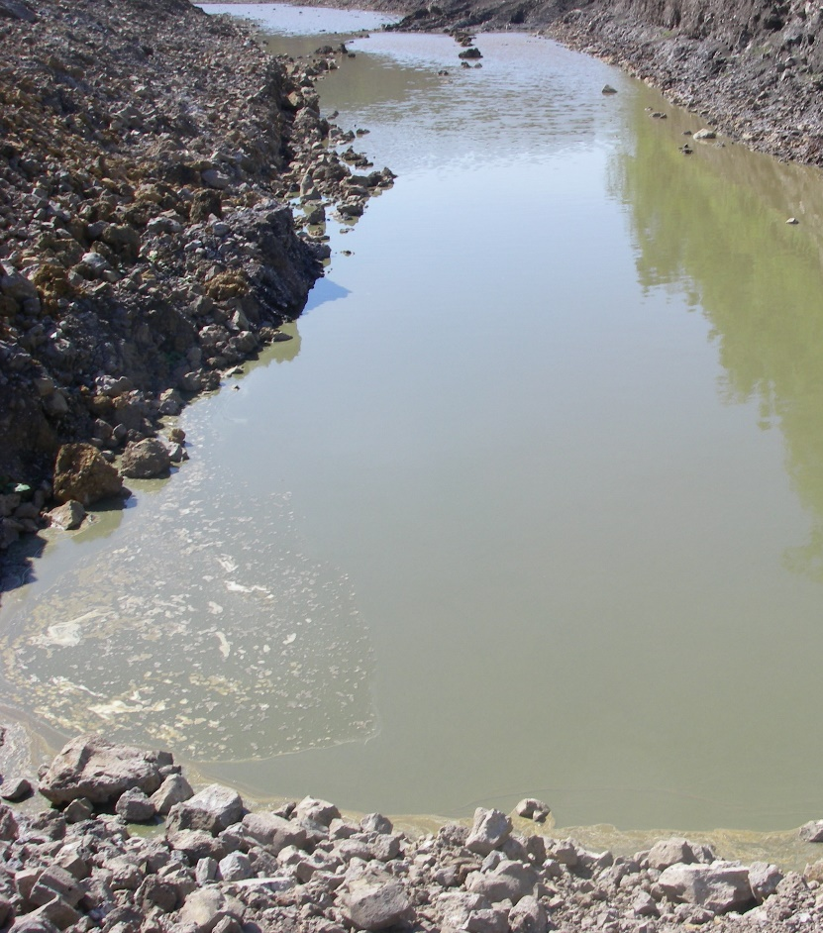
Water Framework Directive
2. Environmental regulations and standards from MS and the EU
The Water Framework Directive (2000/60/EC) and the Groundwater Directive (2006/118/EC)
Quality of natural water bodies
Primary water quality criteria
Tests and associated limit values and risks assessment
Environmental and human health protection vs. Beneficial uses of secondary aggregates
Risk-based limit values set in MS relevant for slag
Notes:
Fitness-check on Water Framework Directive is going on. The report will be available by this summer 2019.
Far-fetching consequences for the mining industries: the industry calls for the need to revise the Water Framework Directive following EU Court of Justice : assessment of ecological status of water bodies: set of criteria; each criteria to be assessed separately. Assessment of good ecological status : pristine waster, areas with no-human activities similar to, pre-industrial situation.
Old way classifying the reference status.
Ecological approach not an holistic approach: One Out or Out Principle.
The extractive waste legislation not coherent with water framework directive.
If the WFD is reopened for revision, it will be next commission not a given fact.

Slide 10
Construction Products Regulation
2. Environmental regulations and standards from MS and the EU
The Construction Products Regulation (CPR, 305/2011/EU) )
Market tool to remove barriers to trade
CE marking to provide a harmonised information format
Basic Work Requirements
CPR is NOT defining health or environmental risk
CPR is NOT setting threshold value
Different national values –one test method
Secondary materials–same performance or additional testing necessary

Slide 11
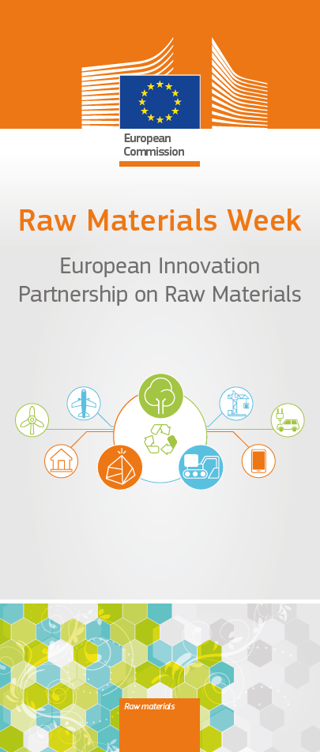

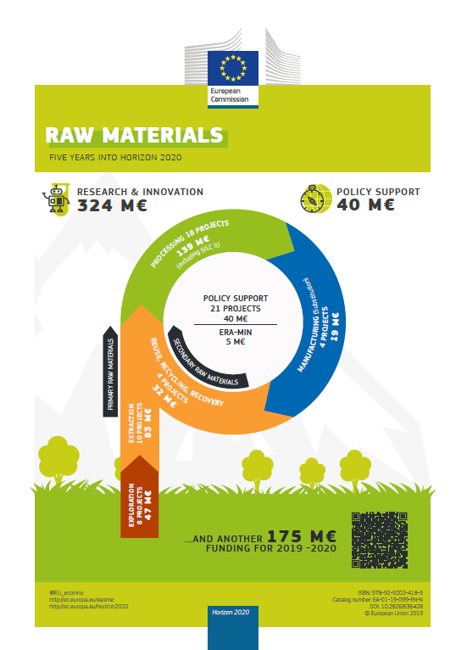
3. Technical, environmental and economic challenges
Research & Development
Different uses and issues
Substantial research work already available
Opportunities for new products, jobs and growth
  Inorganic geo-polymers
  Blended cements
  Building sblocks
  …
Notes:
ReSlag Horizon 2020 Project coordinated by KU Leuven.
JRC Science for Policy Report of critical and other materials form mining waste and landfills to be finalized and published shortly.

Slide 12
3. Technical, environmental and economic challenges
Environmental benefits
Avoid waste streams
Promote recognised by-products
Save energy, environment and landscape impacts associated to extraction
Need to manage safely potential hazardous elements (Pb, Cd)
Knowledge of long-term behaviour
Practical methods and protocol

Slide 13
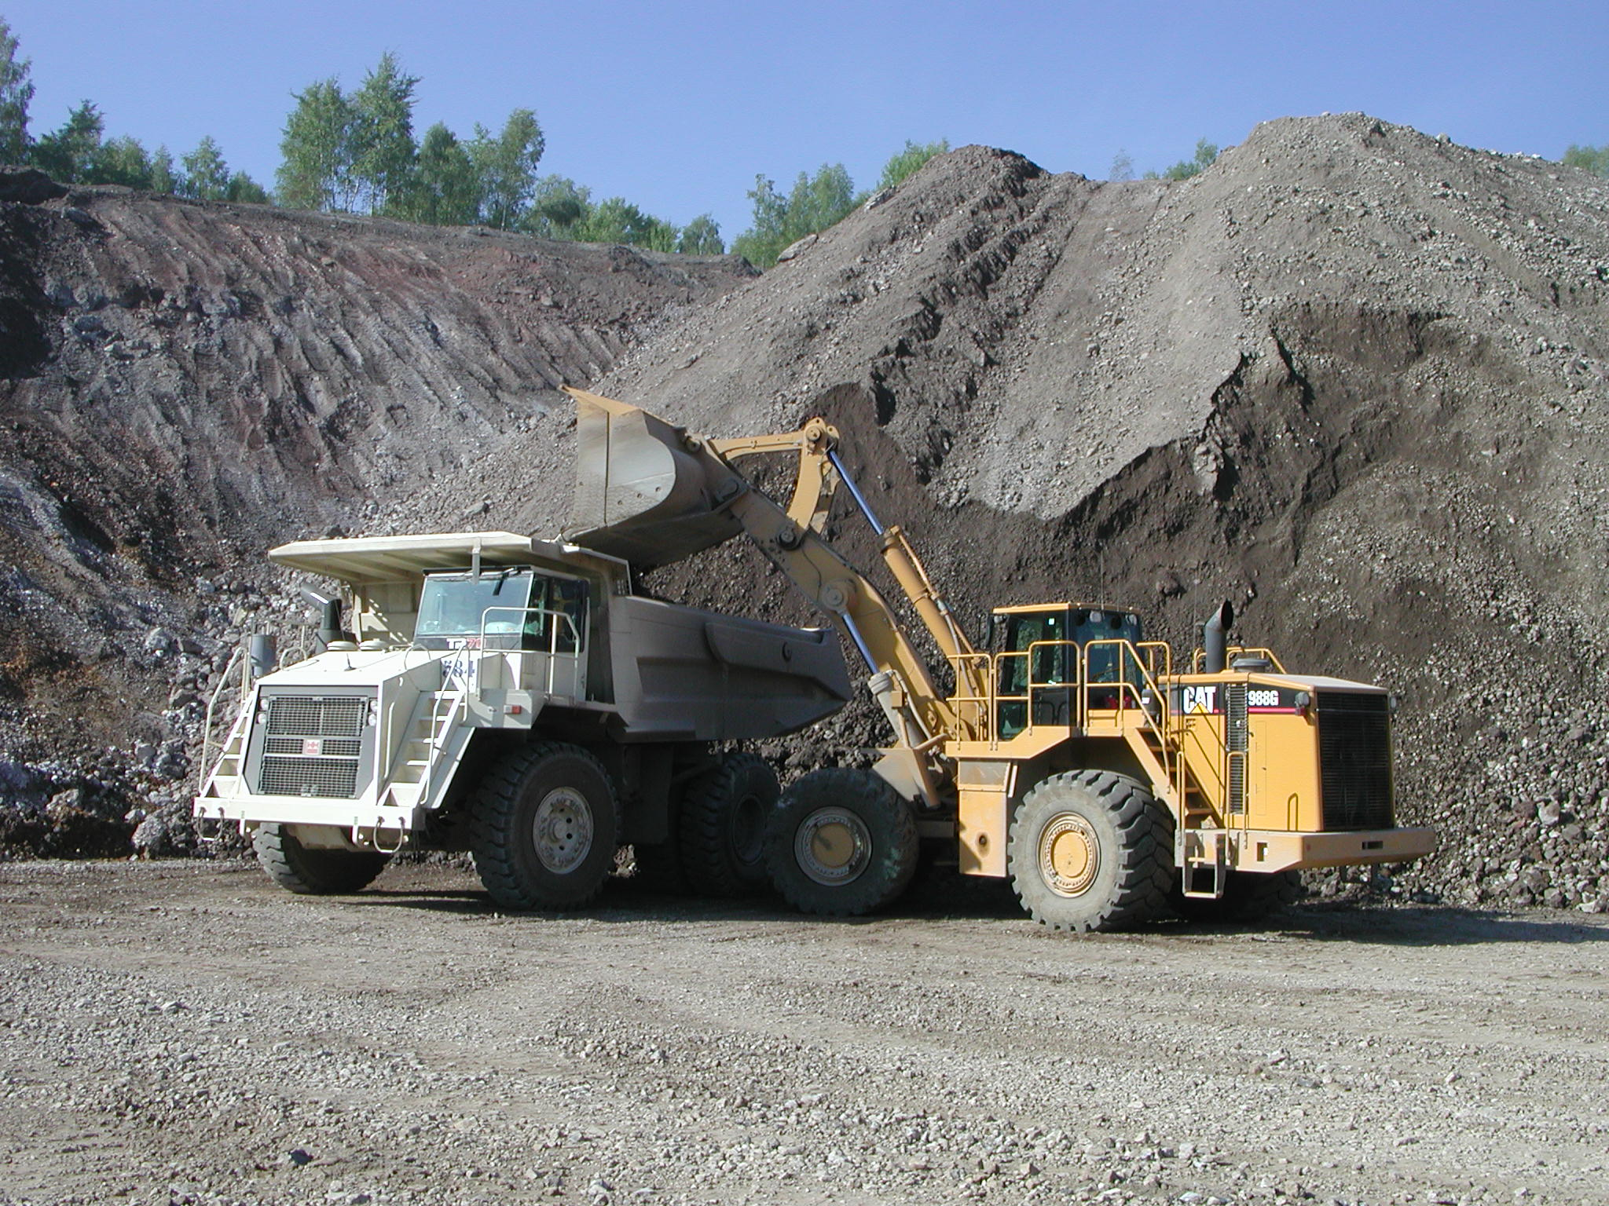
3. Technical, environmental and economic challenges
Marketability and competitiveness
Mostly competing in aggregates markets
Local markets close to steel plants
Cost-efficient < 150 Km
Intra EU 28 trade (BE, FR, LU, NL, DE, PL, AT, CZ)
Extra EU trade = 0

Slide 14
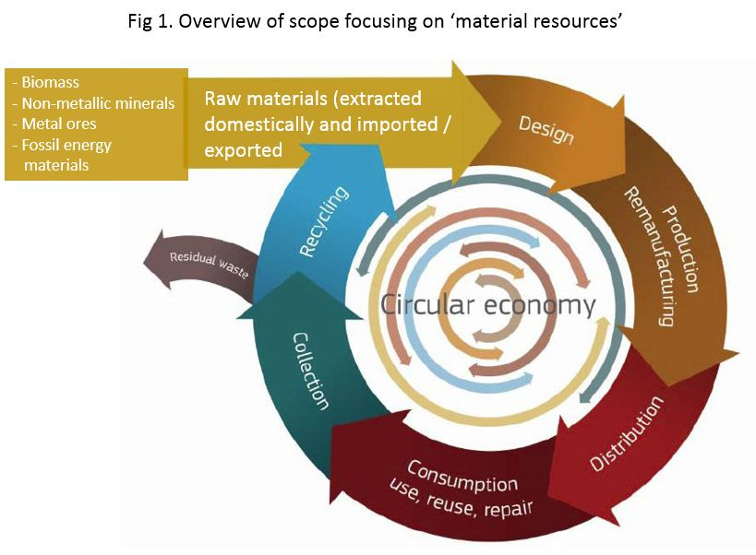
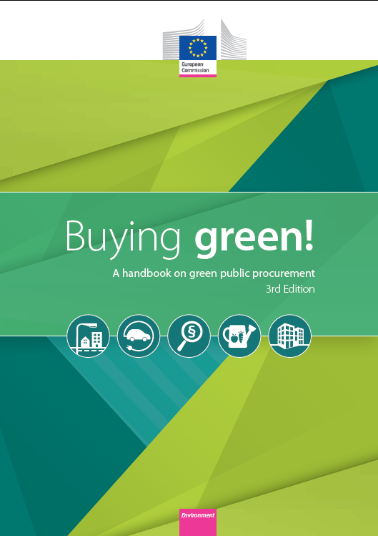
4. EU policies and slag valorisation
Industrial symbiosis within Circular Economy
Resource Efficient Europe Flagship Initiative
Industrial Symbiosis as sustainable production
"Waste or by-products of one industry become inputs for another„
Green Public Procurement = key instrument (public infrastructure and buildings)

Slide 15
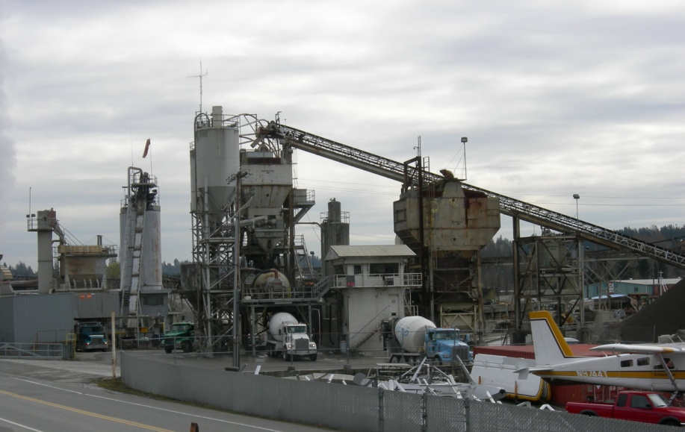
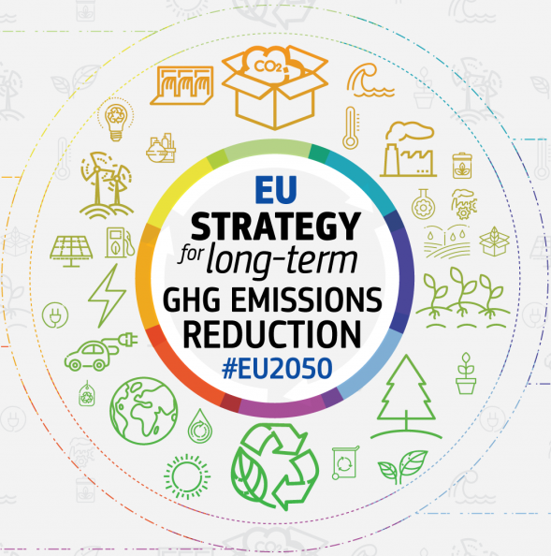
4. EU policies and slag valorisation
CO2 emissions reduction
Carbon footprint reduced
CO2 emissions - 80% in (CEM-II and CEM-III)
24 mT of granulated BF slags = - 22 mT CO2
Low carbon technology

Slide 16
Raw materials policy
Circular Economy Action Plan
Raw Materials Scoreboard 2020
Batteries action plan
Critical Raw Materials 2020
European Innovation Partnership on Raw Materials
Trade
Framework conditions for primary raw materials
Emissions neutral Europe – vision 2050
Research and Innovation

Slide 17
Conclusion
Valorisation of slags corresponds to EU policies
  Circular economy
  Resource efficiency
  European strategic long-term vision for a competitive and climate-neutral economy
Challenges
  Legal status to slag-based products
  Recognition of their market values and their performance/characteristics
  Improve the technical and legislative framework
    Secondary raw materials
    No risks for human health and environment
Cooperation for industrial symbiosis
  Business and technical relations among industrial sectors
  Common practical protocols and relevant standards
Industrial symbiosis
Circular economy
Low carbon technology
Misconceptions
Notes:
The valorisation of slag-based products is an objective that fully corresponds to EU policies with regard to the circular economy through resource efficiency and the European strategic long-term vision for a competitive and climate-neutral economy. However, some challenges still needs to be tackled and solved: to secure a proper legal status to slag-based products, in recognising their market values and their performance/characteristics in targeted applications; to improve the technical and legislative framework in order to ensure a balanced outcome in which slag-based products and more in general secondary raw materials are not put at disadvantage compared to virgin raw materials and the risks for human health and environment are under full control.
To achieve this ambition, the industrial sectors concerned have still to deepen their cooperation aiming at establishing a larger industrial symbiosis basis. In such condition, business and technical relations among industrial sectors will be streamlined, together with their common practical protocols and relevant standards.
Industrial actors, Member States and relevant European stakeholders and authorities should work together to clarify common approaches and interpretations, to harmonise relevant regulations, criteria and standards for the valorisation of slags and to unleash its full potential for the benefit of EU environment and economy and the European industrial sectors.

Slide 18
Thank you!
Relevant links
EU Raw materials, metals, minerals and forest-based industries:
https://ec.europa.eu/growth/sectors/raw-materials_en
EIP on Raw Materials:
https://ec.europa.eu/growth/tools-databases/eip-raw-materials/en
Horizon 2020 - raw materials and calls:
https://ec.europa.eu/research/participants/portal/desktop/en/opportunities/h2020/index.html
JRC (2014) Best Available Techniques (BAT) Reference Document for the Non-Ferrous Metals Industries, Final Draft (October 2014), 1242 pp. accessible from:
http://eippcb.jrc.ec.europa.eu/reference/BREF/NFM_Final_Draft_10_2014.pdf
COM(2018) 773 final - A Clean Planet for all - A European strategic long-term vision for a prosperous, modern, competitive and climate neutral economy - https://ec.europa.eu/clima/sites/clima/files/docs/pages/com_2018_733_en.pdf
In-depth analysis in support of the commission communication COM(2018) 773 - https://ec.europa.eu/clima/sites/clima/files/docs/pages/com_2018_733_analysis_in_support_en_0.pdf
COM(2012) 82 final - Making raw materials available for Europe's future wellbeing proposal for a European innovation partnership on raw materials - https://eur-lex.europa.eu/legal-content/EN/TXT/?uri=CELEX:52012DC0082
Notes:
18

